Slide 1
Communication protocols with Arduino
SUTD IEEE Student Chapter

Slide 2
Agenda
Theory
What are they?
Why do I need them?
How do I use them?
Practical
Hooking up some devices to the Arduino with Serial Comm.

Slide 3

What Are Serial Communication Protocols
Method of sending (and receiving) data and that is serialized, to other devices or peripherals.
Protocols specify how exactly the data is sent, how exactly the device is supposed to be connected, how fast it should send data, etc.
Three different serial communication protocols on Arduino:
TTL Serial
SPI
I²C

Slide 4
Why Do I need these communication Protocols
Arduino supports both Digital and Analogue OUTPUTS and INPUTS
Connect sensors such as LDRs, Ultrasonic sensors, etc.
Control components such as motors, LEDs, etc.
What about more complex devices such as accelerometers, LCDs, controlling LED displays?

Slide 5
Why Do I need these communication Protocols
Communication Protocols allow transfer of data between devices
Eg. Use an LCD by specifying the coordinates of a pixel to be turned on or off.

Slide 6
Brief Summary of Communication Protocols on Arduino
TTL Serial | SPI | I²C
Asynchronous | Synchronous | Synchronous
Between 2 devices | 1 Master to many Slaves | Many Masters to many Slaves (Max 121 for Arduino)
TX/ RX Pins | MOSI, MISO, SCK, SS | SDA, SCL
Fast | Very fast | Not that fast
Common applications: GPS, Bluetooth Modules Microcontrollers | Common applications: Sensors, Touchscreens, Control devices (eg. Digital Pots), Memory, LCD | Common applications: Small LCD/ OLED, Sensors, EEPROMs, Display connectors

Slide 7
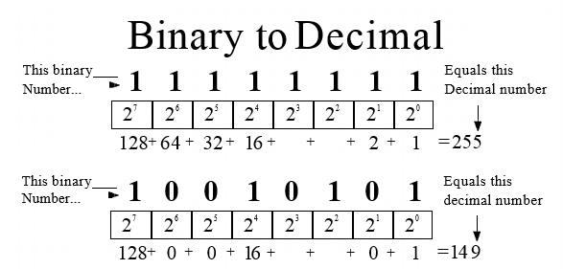
But Before That …
What exactly is serial data?
Sequence of binary digits (1’s and 0’s) sent one after another to form (usually) 8-bit binary numbers (sequence of 8 - 1’s and 0’s)
These numbers can then be converted to decimal or interpreted as ASCII or Unicode characters.

Slide 8
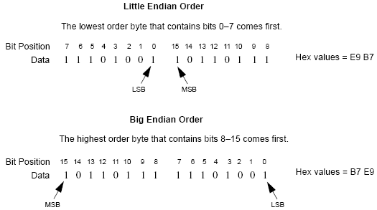
Binary Data
Which bit is sent first – right most bit or left most bit?
Little vs Big Endian

Slide 9
How to use communication protocols
TTL Serial
SPI
I²C

Slide 10
TTL Serial
Can be asynchronous or synchronous – Arduino is asynchronous
Asynchronous
Communication synchronized with start/stop bits (messages)
Synchronous
Communication synchronized with external clock
Stands for Transistor-Transistor Logic
Notes:
Why is synchronization important?

Slide 11
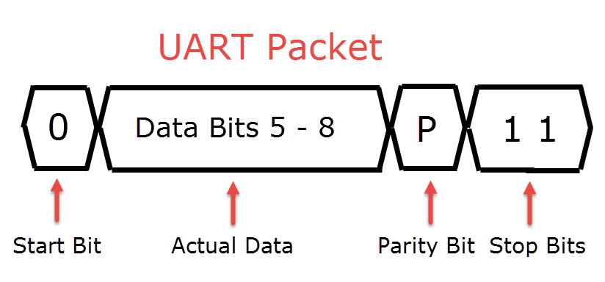
TTL Serial
Uses a UART as a hardware intermediary
Can also be implemented via software (bit-banging) i.e. Arduino SoftwareSerial Library
Star-Bit
Data Bits
Parity Bit (Optional)
Stop Bit(s)

Slide 12
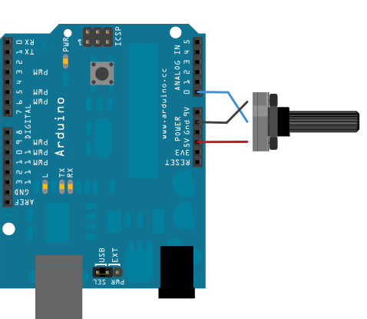
TTL Serial - Transmitting

Slide 13
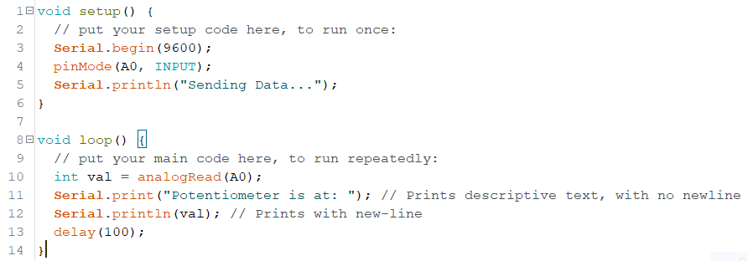
TTL Serial - Transmitting

Slide 14
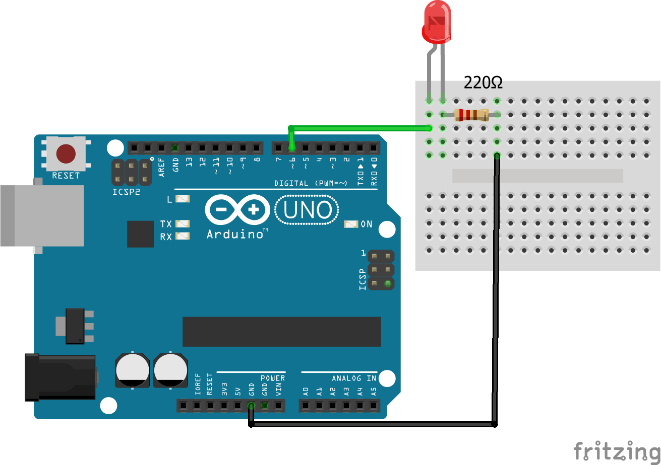
TTL Serial - Receiving

Slide 15
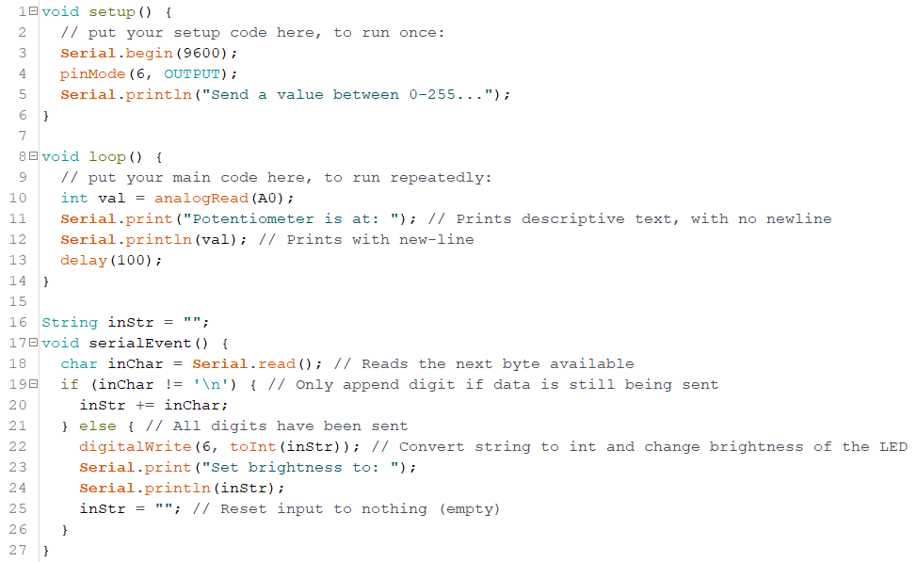
TTL Serial - Receiving
inStr.toInt()

Slide 16
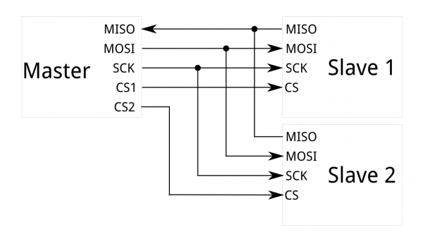
SPI
Serial Peripheral Interface
Synchronous Interface
Uses a Master-Slave concept
Allows 1 Master to many Slaves
Multiple-Masters not possible

Slide 17
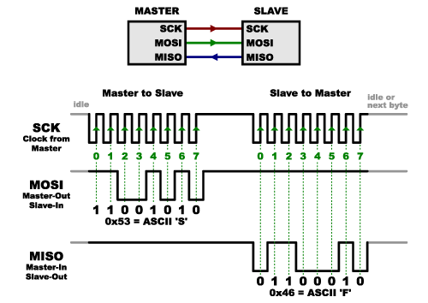
SPI
Data structure is very simple
No start bit, stop bit, or parity bit
Very fast!
Data is sent on rising or falling edge of clock cycle.

Slide 18
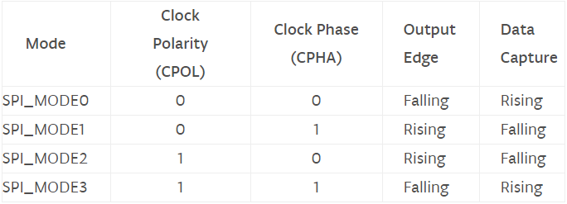
SPI with Arduino
Arduino Uno (ATMega328P) has one SPI Bus
Uses library <SPI.h>
#include at the start
Using the library:
SPI.begin() // Does not take any parameters
SPISettings(SPEED, DATAORDER, DATAMODE)
For understanding: http://dlnware.com/dll/Clock-Phase-and-Polarity

Slide 19
SPI with Arduino
Using the library:
SPI.beginTransaction(SPISettings)
SPI.transfer(DATA)
SPI.endTransaction()
SPI.end()
SPI.usingInterrupt(PIN)

Slide 20
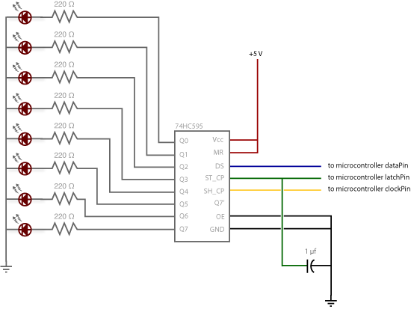
SPI with Arduino
Can be used to control a shift register – which allows a sequence of bits to be ‘shifted’ and set a series of (usually) 8 outputs on or off
Thus, they ‘expand’ the Arduino’s output pins
ST_CP goes to ground
DS goes to MOSI
SH_CP goes to SCK

Slide 21
SPI - TRY IT OUT
Call SPI.begin() in setup()
In loop():
Create a loop to count from 0 to 255 and write that data to the shift register via SPI.transfer()
Execute SPI.beginTransaction(SPISettings(1000,MSBFIRST,SPI_MODE0)) before the transfer and execute SPI.endTransaction() after

Slide 22
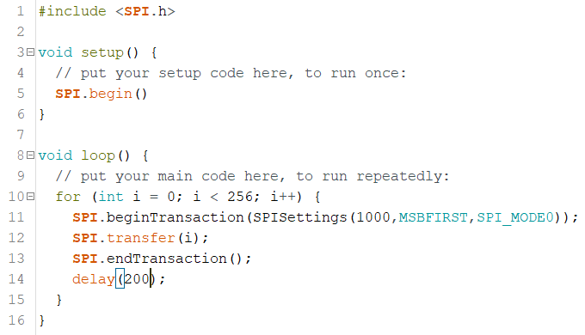
SPI - Final Code

Slide 23
SPI - Challenge
Try to make a Decade counter with this setup
Only one LED on at a time

Slide 24
I²C
Inter-Integrated Circuit
Only 2 Wires – SDA (Serial Data) and SCL (Serial Clock)
How? Using an address (7-8 bits) per device connected
Connect 120 devices at once! (8 reserved addresses)
Is able to identify which device is sending or receiving data

Slide 25
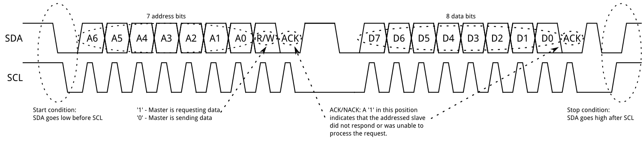
I²C on Arduino
SDA – A4
SCL – A5
If connecting with device that runs on 3.3 V, pull SDA and SCL pins to high (5V) via a resistor

Slide 26
I²C on Arduino
<Wire.h>
begin()
requestFrom()
beginTransmission()
endTransmission()

Slide 27
I²C on Arduino
write()
available()
read()
SetClock()
onReceive()
onRequest()

Slide 28
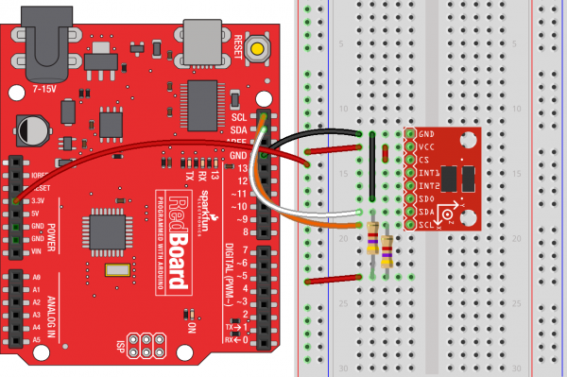
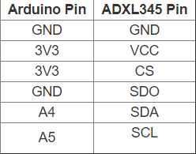
I²C on Arduino
ADXL345
https://learn.sparkfun.com/tutorials/adxl345-hookup-guide?_ga=2.1431734.625444

Slide 29
I²C on Arduino
[Go through demo]

Slide 30
I²C on Arduino
Adafruit has written a great library to use the ADXL345, but what’s going on in the background?
I²C is used to read from / write to particular memory address in the ADXL345 which contain info about accelerometer data, temperature, etc. and other configuration options.

Slide 31
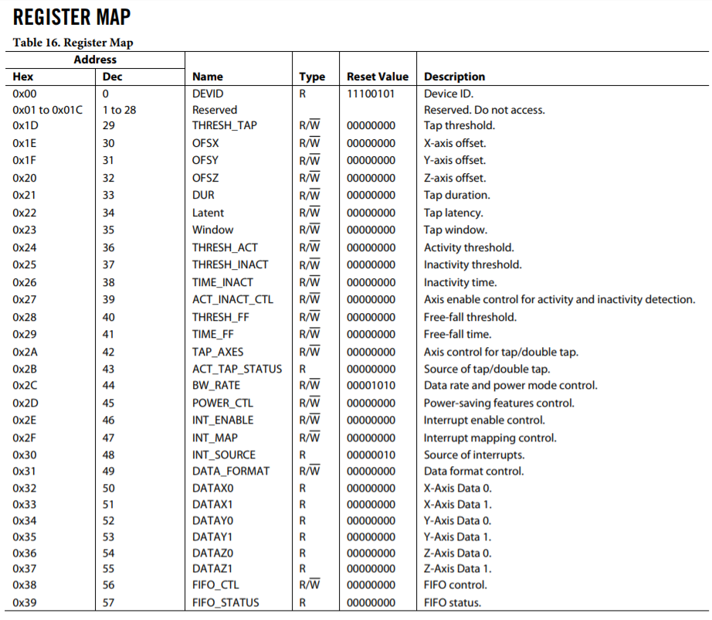
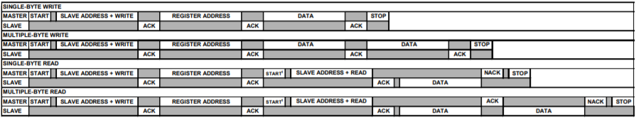
ADXL345 I²C Datasheet
https://www.sparkfun.com/datasheets/Sensors/Accelerometer/ADXL345.pdf Pages 10 and 14

Slide 32
Summary of Communication Protocols Learnt Today
TTL Serial | SPI | I²C
Asynchronous | Synchronous | Synchronous
Between 2 devices | 1 Master to many Slaves | Many Masters to many Slaves (Max 121 for Arduino)
TX/ RX Pins | MOSI, MISO, SCK, SS | SDA, SCL
Fast | Very fast | Not that fast
Common applications: GPS, Bluetooth Modules Microcontrollers | Common applications: Sensors, Touchscreens, Control devices (eg. Digital Pots), Memory, LCD | Common applications: Small LCD/ OLED, Sensors, EEPROMs, Display connectors (HDMI, VGA, etc.)

Slide 33
Serial Communication
There are so many others for different purposes!
Short range vs long range
Fast vs slow
Easy vs complex
…
Just visit the Wikipedia page and find out more!

Slide 34
Thank You for Coming

